Slide 1
Malignant Comment Classifier Project
Submitted by:
Shubham Sahu

Slide 2
BUSINESS PROBLEM FRAMING
The proliferation of social media enables people to express their opinions widely online. However, at the same time, this has resulted in the emergence of conflict and hate, making online environments uninviting for users. Although researchers have found that hate is a problem across multiple platforms, there is a lack of models for online hate detection.
Online hate, described as abusive language, aggression, cyberbullying, hatefulness and many others has been identified as a major threat on online social media platforms. Social media platforms are the most prominent grounds for such toxic behaviour.
There has been a remarkable increase in the cases of cyberbullying and trolls on various social media platforms. Many celebrities and influences are facing backlashes from people and have to come across hateful and

Slide 3
BUSINESS PROBLEM FRAMING
offensive comments. This can take a toll on anyone and affect them mentally
leading to depression, mental illness, self-hatred and suicidal thoughts.
Internet comments are bastions of hatred and vitriol. While online anonymity has provided a new outlet for aggression and hate speech, machine learning can be used to fight it. The problem we sought to solve was the tagging of internet comments that are aggressive towards other users. This means that insults to third parties such as celebrities will be tagged as unoffensive, but “u are an idiot” is clearly offensive.
Our goal is to build a prototype of online hate and abuse comment classifier which can used to classify hate and offensive comments so that it can be controlled and restricted from spreading hatred and cyberbullying.

Slide 4
ANALYTICAL PROBLEM FRAMING
I have used the TF-IDF to vectorize the words so that machine can understand the words.
TF – Term Frequency (the number of times the words/terms appear in a document.)
IDF - Inverse Document Frequency. (If a word appears in all documents, then it may not play such a big part in differentiating between the documents. IDF is a way of identifying such words)
Document Frequency(term t) = number of documents with the term t/ total number of documents = d(t)/n
Inverse Document Frequency = total number of documents / number of documents with the term t = n / d(t)

Slide 5
DATA SET
The data set includes:
Malignant: It is the Label column, which includes values 0 and 1, denoting if the comment is malignant or not.
Highly Malignant: It denotes comments that are highly malignant and hurtful.
Rude: It denotes comments that are very rude and offensive.
Threat: It contains indication of the comments that are giving any threat to someone.
Abuse: It is for comments that are abusive in nature.

Slide 6
DATA SET
Loathe: It describes the comments which are hateful and loathing in nature.
ID: It includes unique Ids associated with each comment text given.
Comment text: This column contains the comments extracted from various social media platforms.

Slide 7
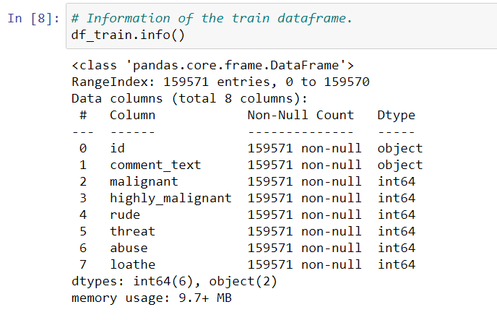
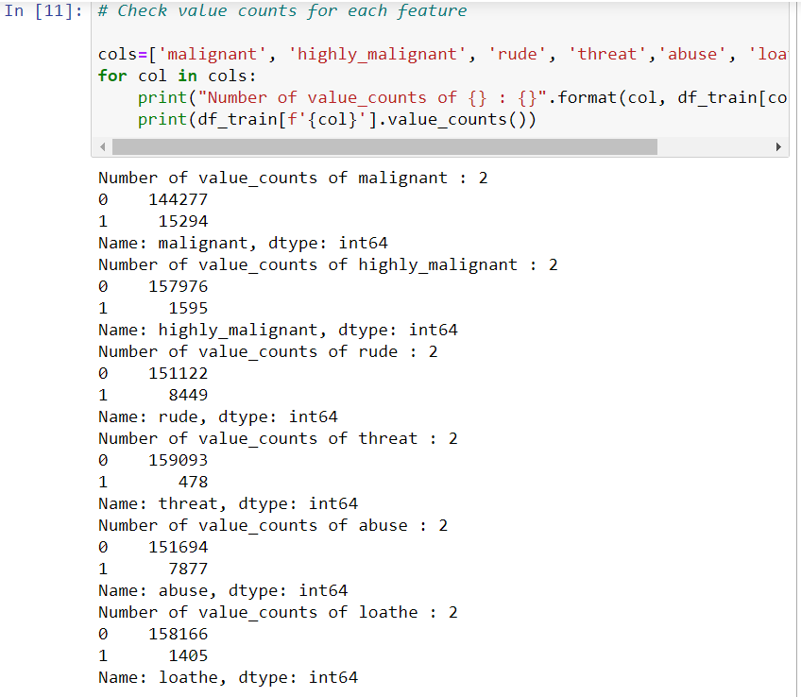
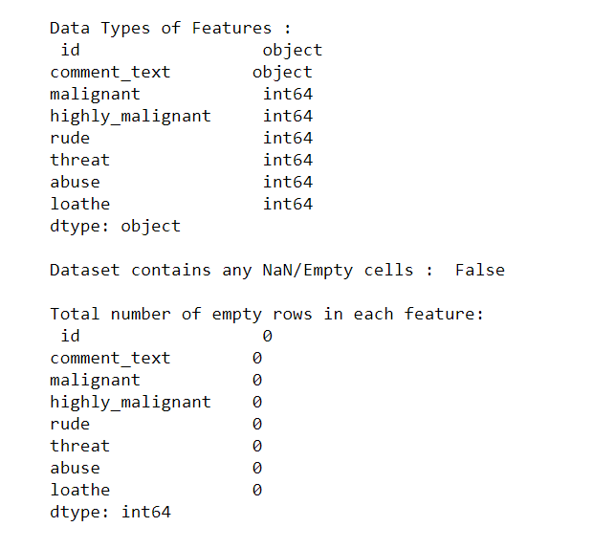
DATA SET

Slide 8
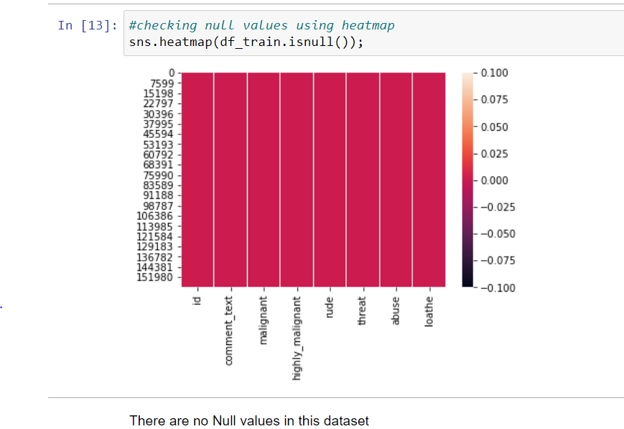
DATA PRE PROCESSING
Checking for Null Values

Slide 9
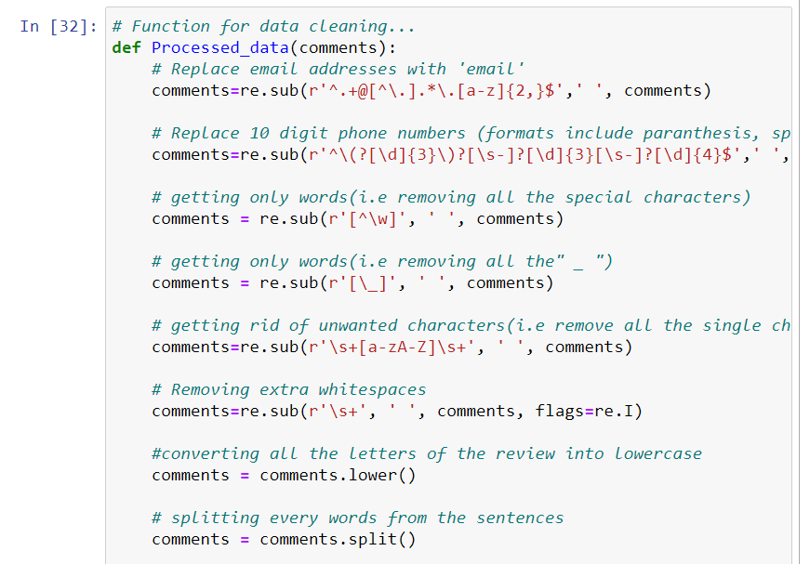
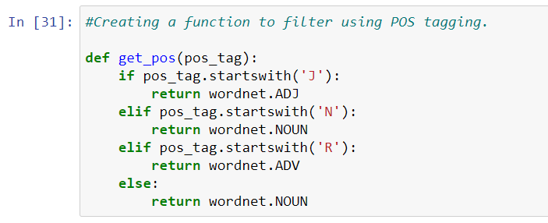
DATA PRE PROCESSING
Cleaning the data set

Slide 10
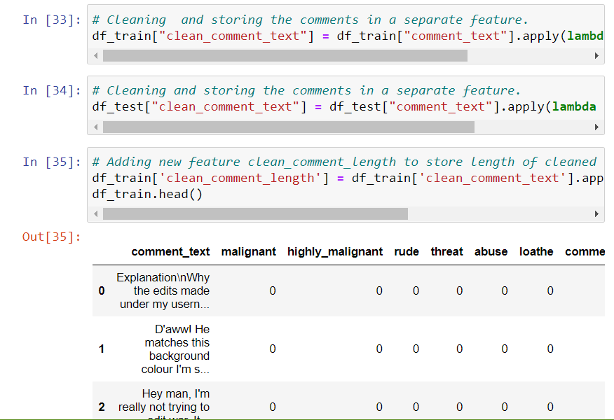
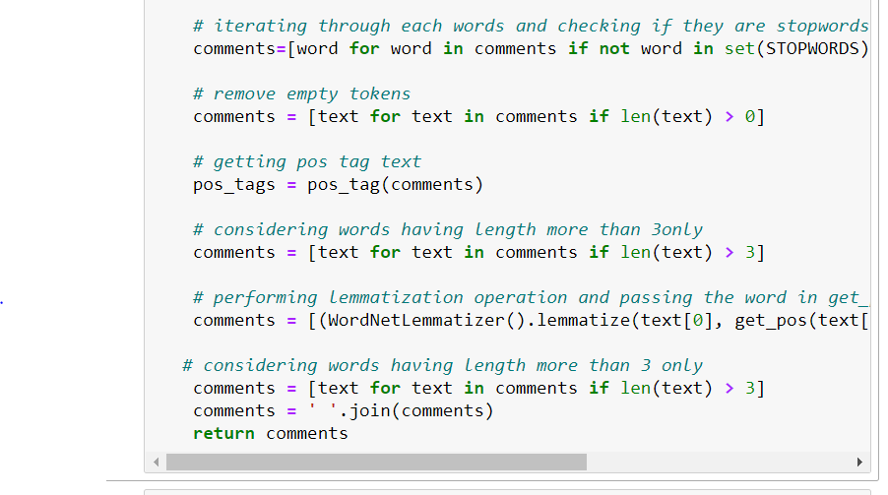
DATA PRE PROCESSING
Cleaning the data set

Slide 11
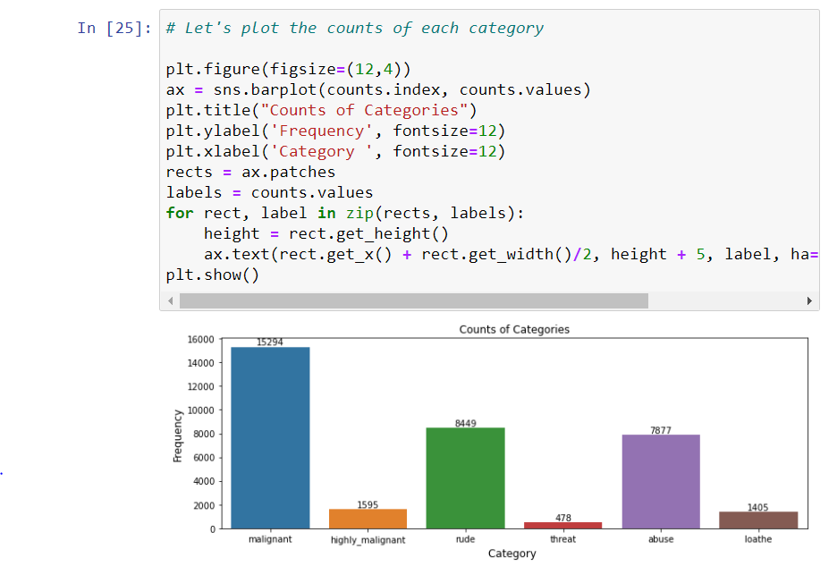
EXPLORATORY DATA ANALYSIS (EDA)

Slide 12
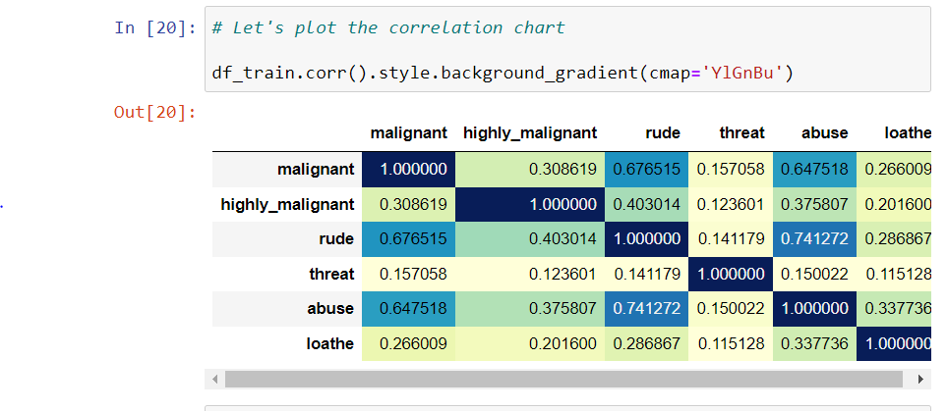
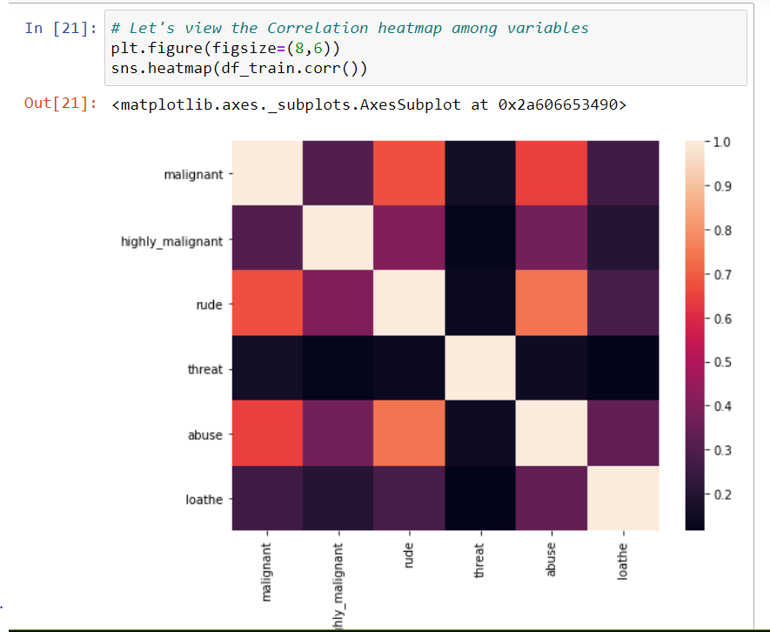
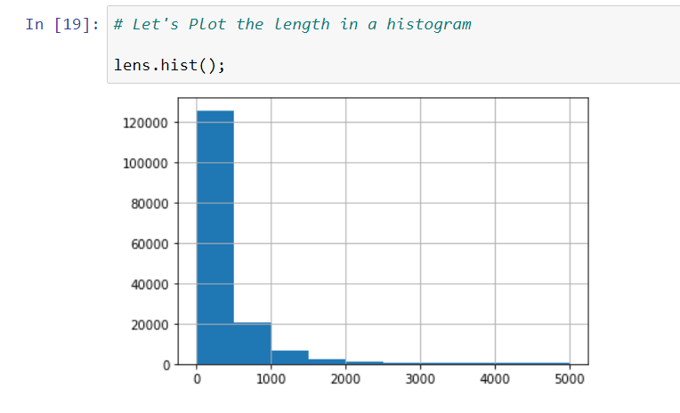
EXPLORATORY DATA ANALYSIS (EDA)

Slide 13
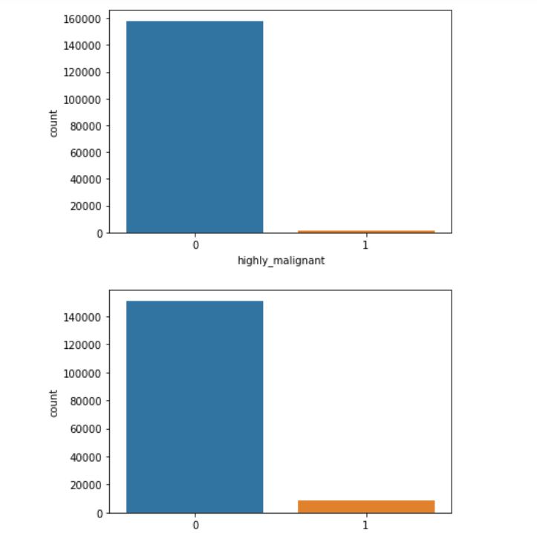
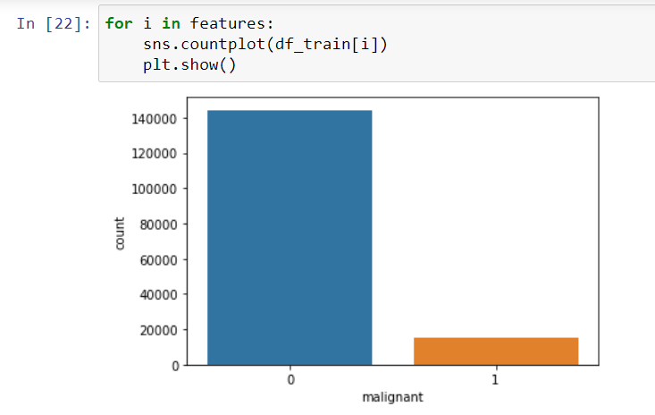
EXPLORATORY DATA ANALYSIS (EDA)

Slide 14
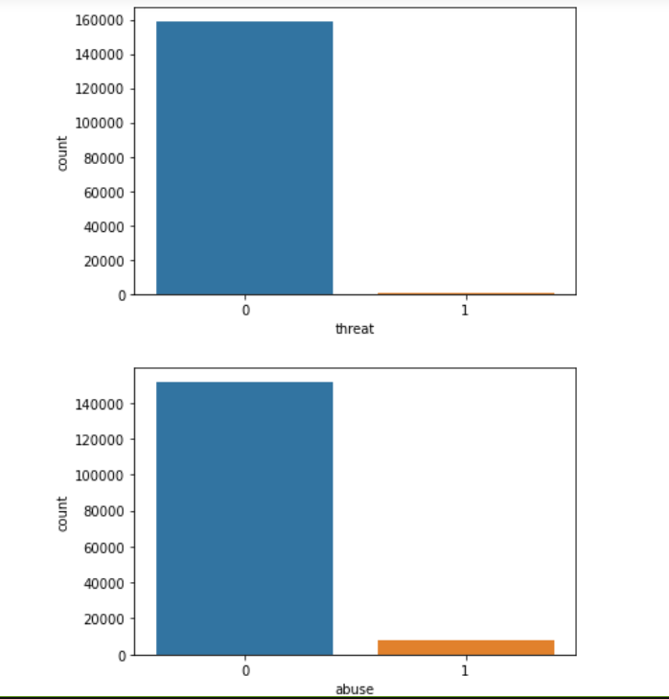
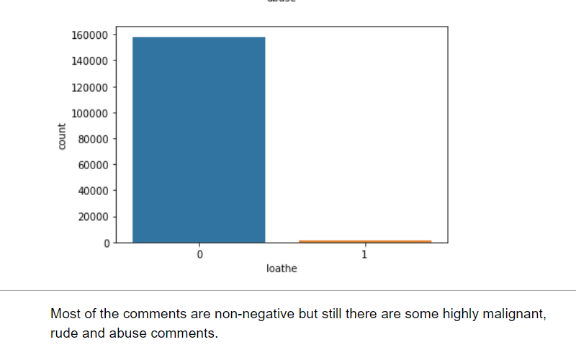
EXPLORATORY DATA ANALYSIS (EDA)

Slide 15
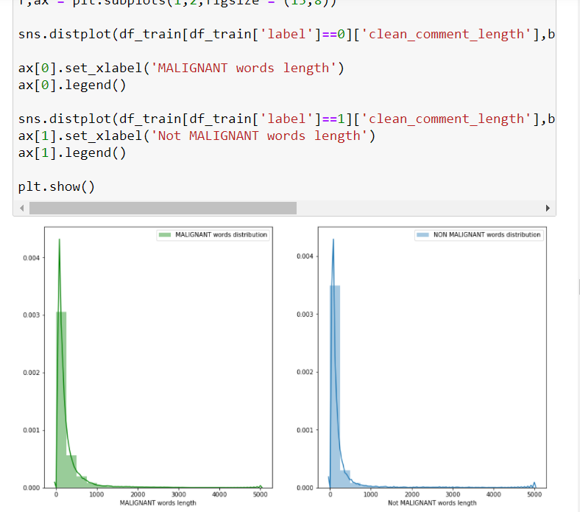
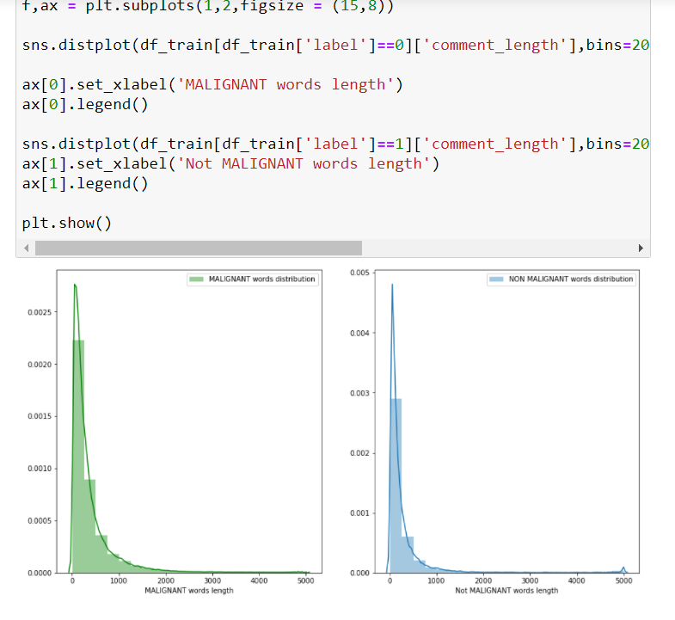
EXPLORATORY DATA ANALYSIS (EDA)

Slide 16
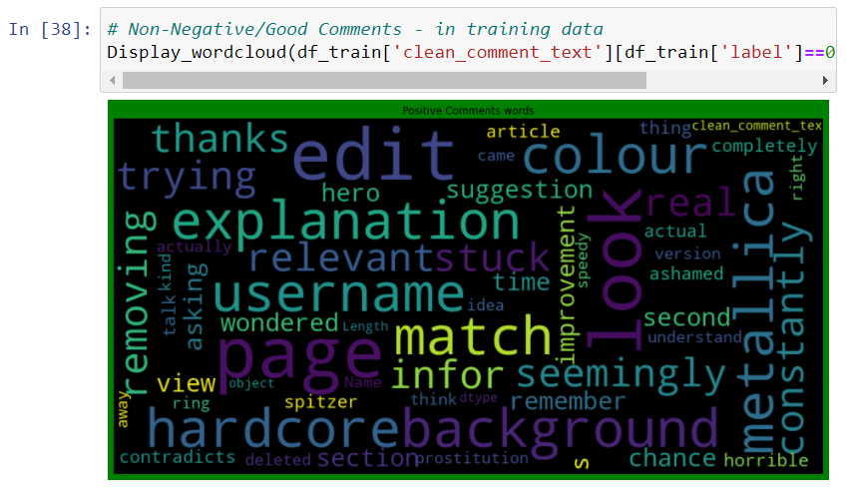
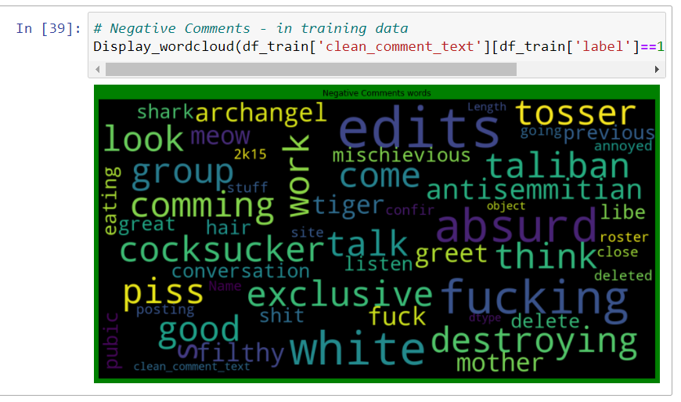
EXPLORATORY DATA ANALYSIS (EDA)
WORD-CLOUDS
Malignant Words:
NoN Malignant Words:

Slide 17
ADDED NEW FEATURE – COMMENT LABEL

Slide 18
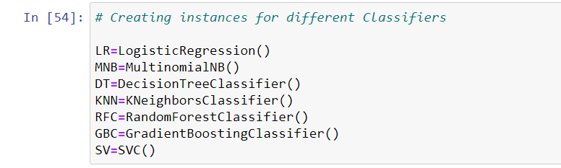
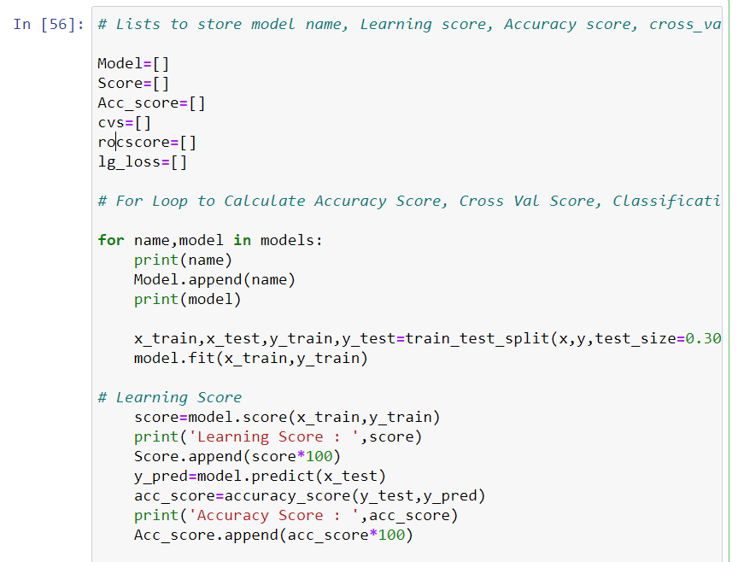
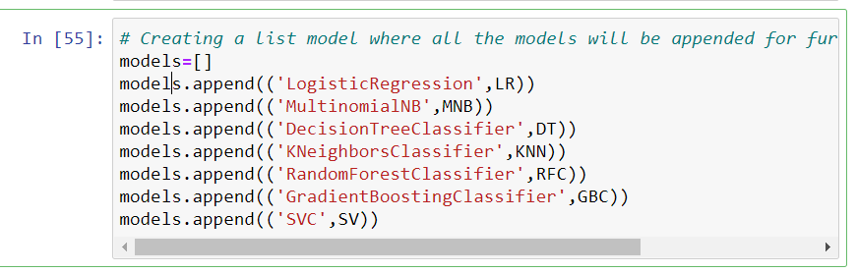
MODEL PREPRATION
The “clean comment text” feature has a notable reduction in the number of characters.

Slide 19
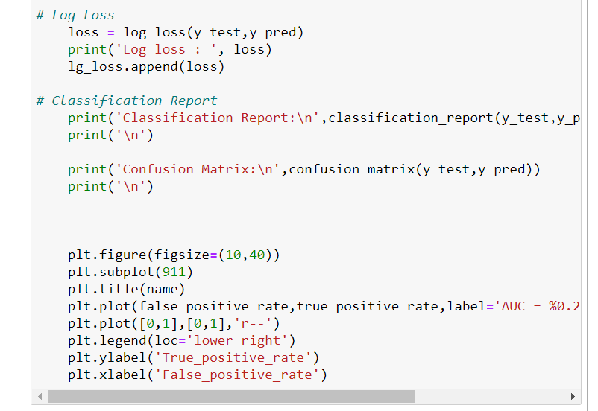
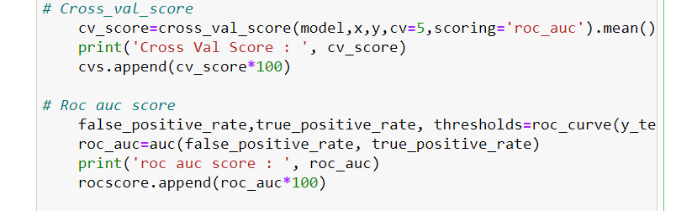
MODEL PREPRATION
The “clean comment text” feature has a notable reduction in the number of characters.

Slide 20
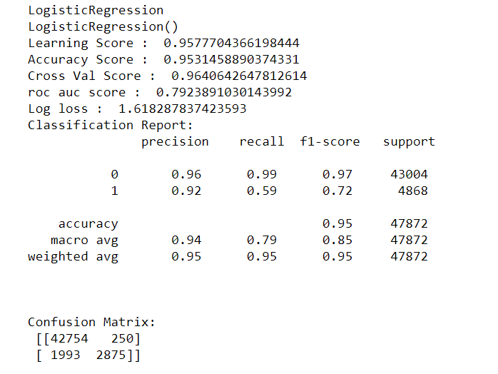
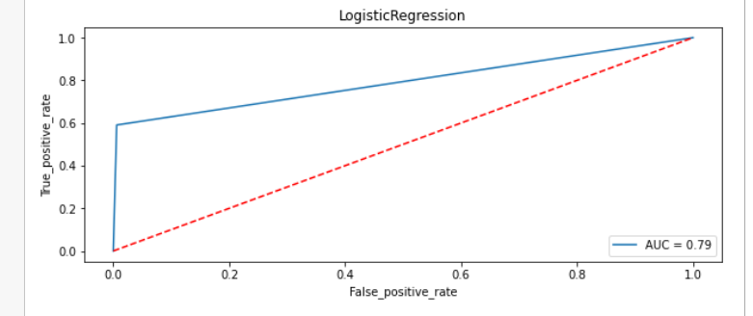
MODEL OUTPUT
The “clean comment text” feature has a notable reduction in the number of characters.

Slide 21
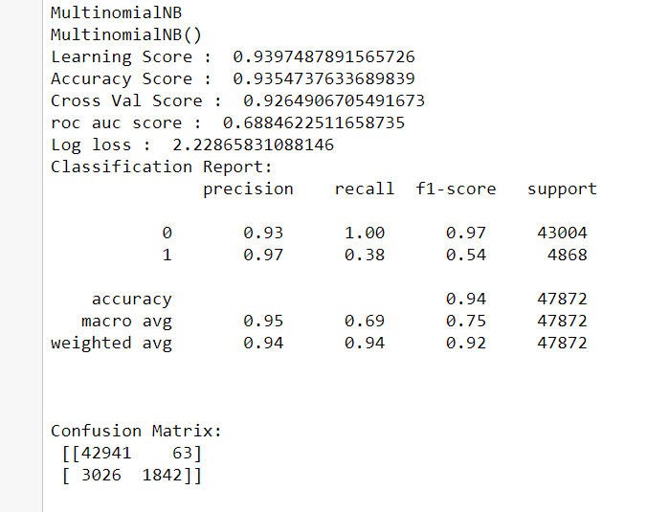
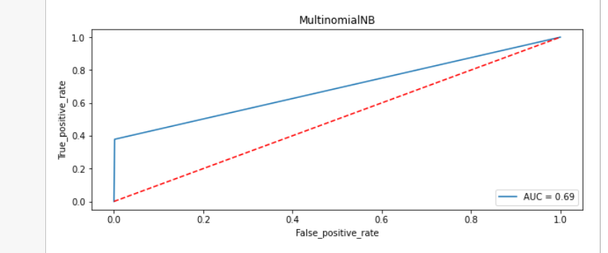
MODEL OUTPUT
The “clean comment text” feature has a notable reduction in the number of characters.

Slide 22
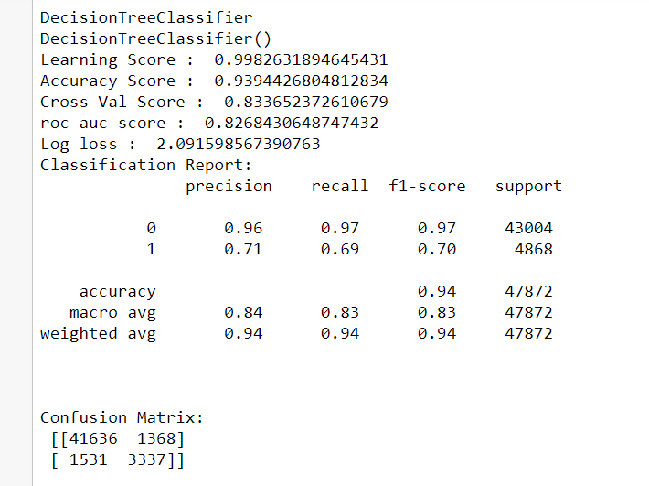
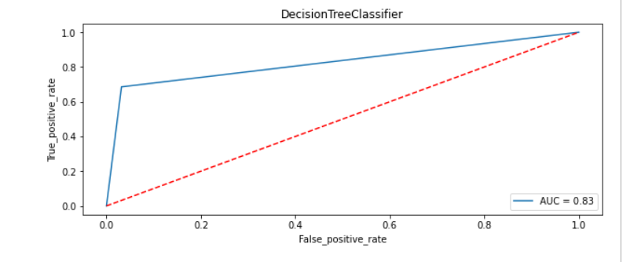
MODEL OUTPUT
The “clean comment text” feature has a notable reduction in the number of characters.

Slide 23
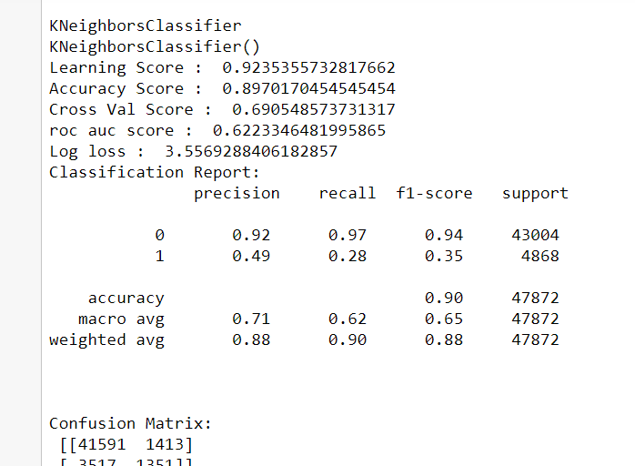
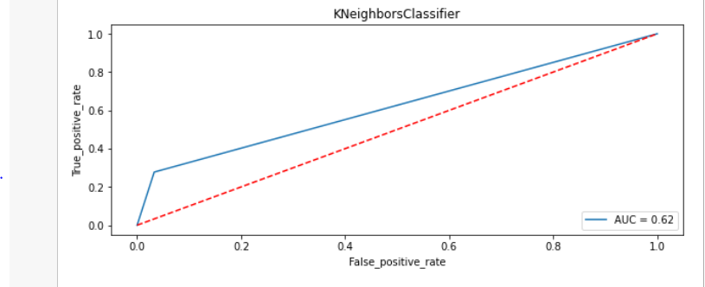
MODEL OUTPUT
The “clean comment text” feature has a notable reduction in the number of characters.

Slide 24
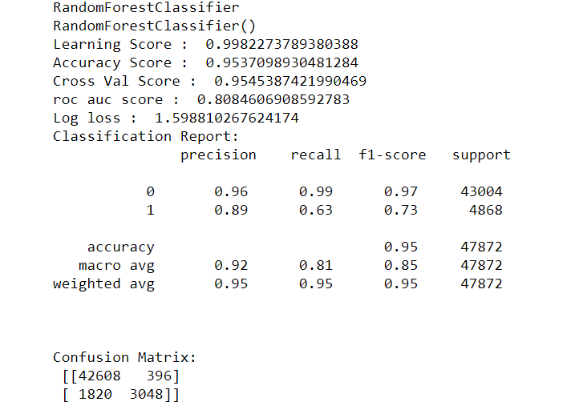
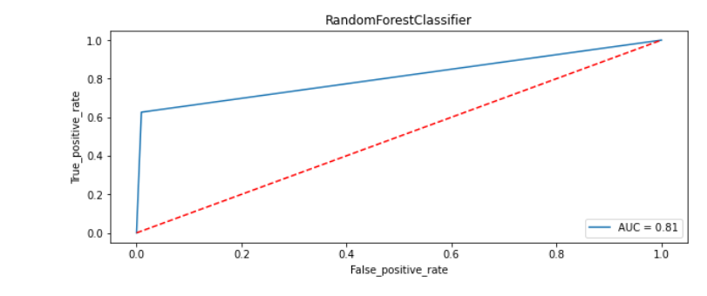
MODEL OUTPUT
The “clean comment text” feature has a notable reduction in the number of characters.

Slide 25
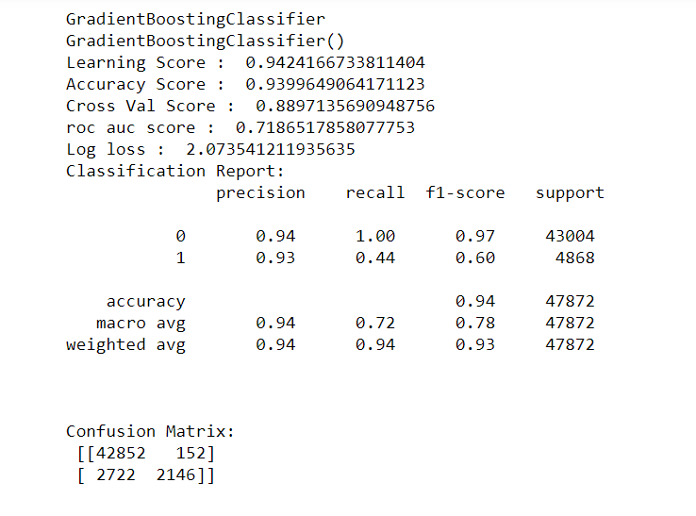
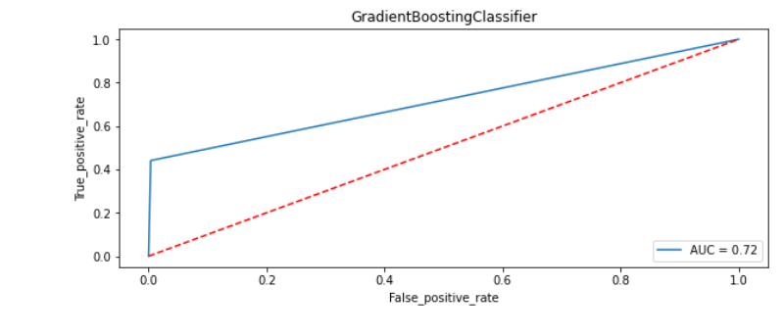
MODEL OUTPUT
The “clean comment text” feature has a notable reduction in the number of characters.

Slide 26
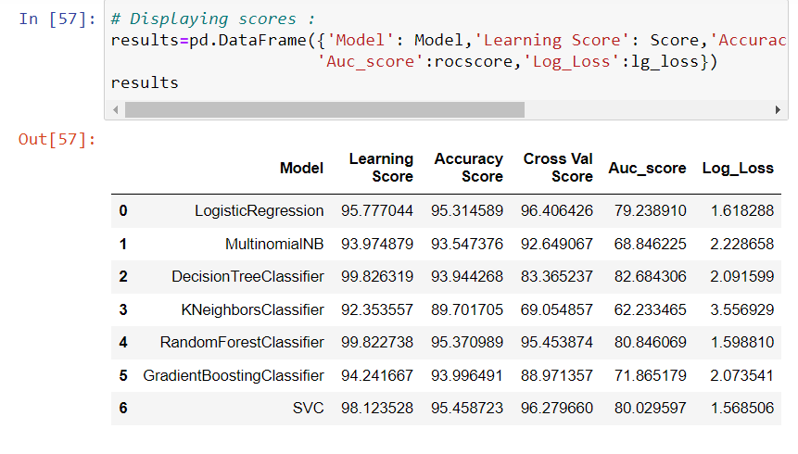
MODEL SCORES SUMMARY
The “clean comment text” feature has a notable reduction in the number of characters.

Slide 27
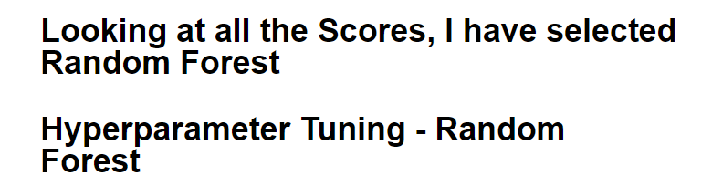
MODEL OUTPUT
The “clean comment text” feature has a notable reduction in the number of characters.

Slide 28
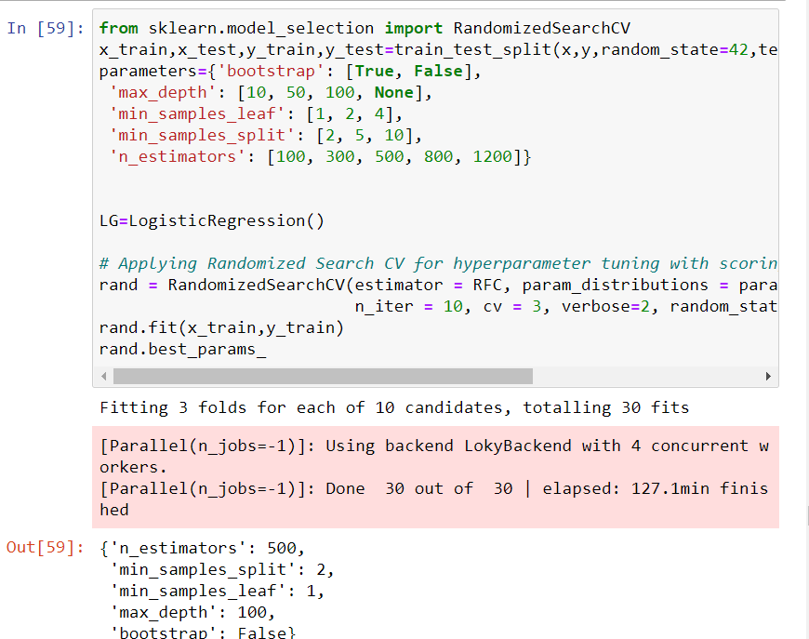
FINAL MODEL
The “clean comment text” feature has a notable reduction in the number of characters.

Slide 29
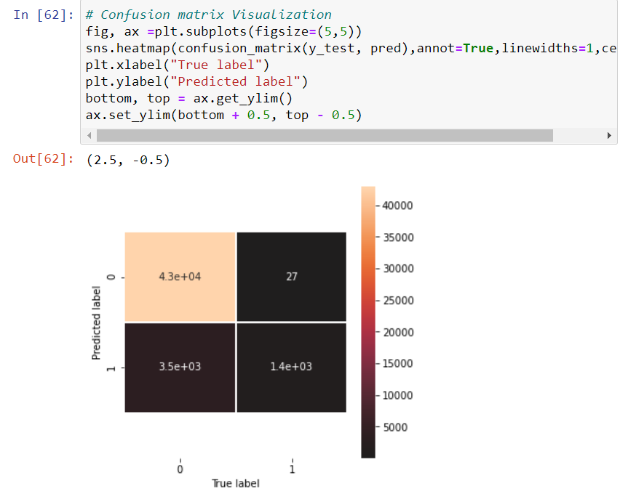
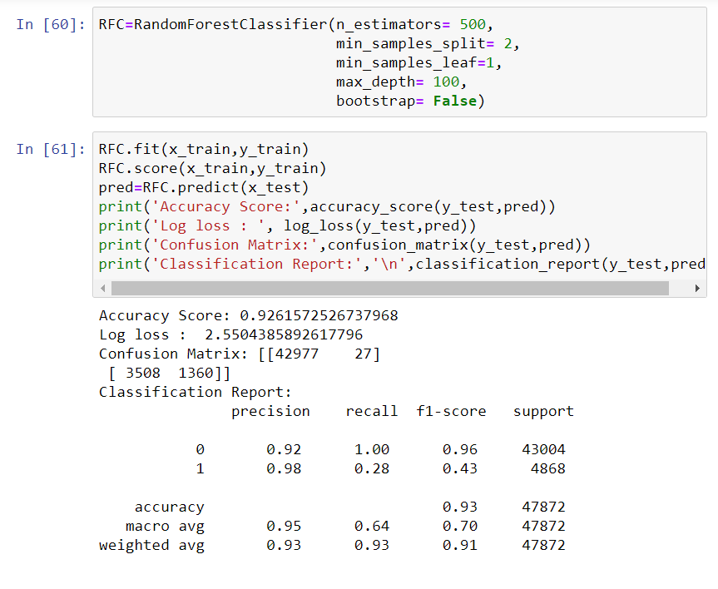
FINAL MODEL
The “clean comment text” feature has a notable reduction in the number of characters.

Slide 30
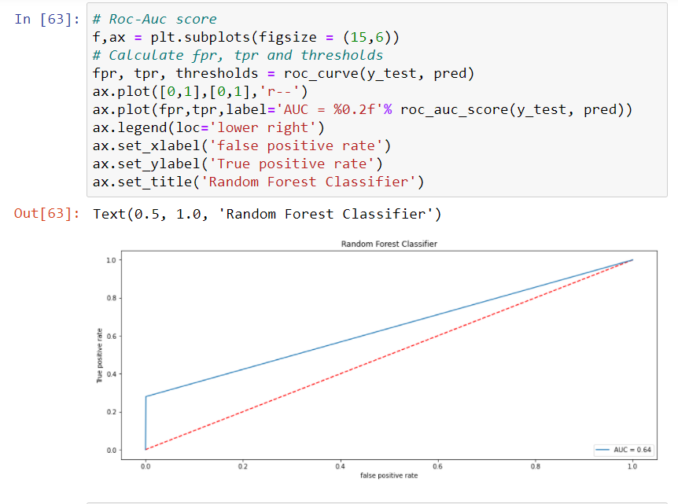
FINAL MODEL
The “clean comment text” feature has a notable reduction in the number of characters.

Slide 31
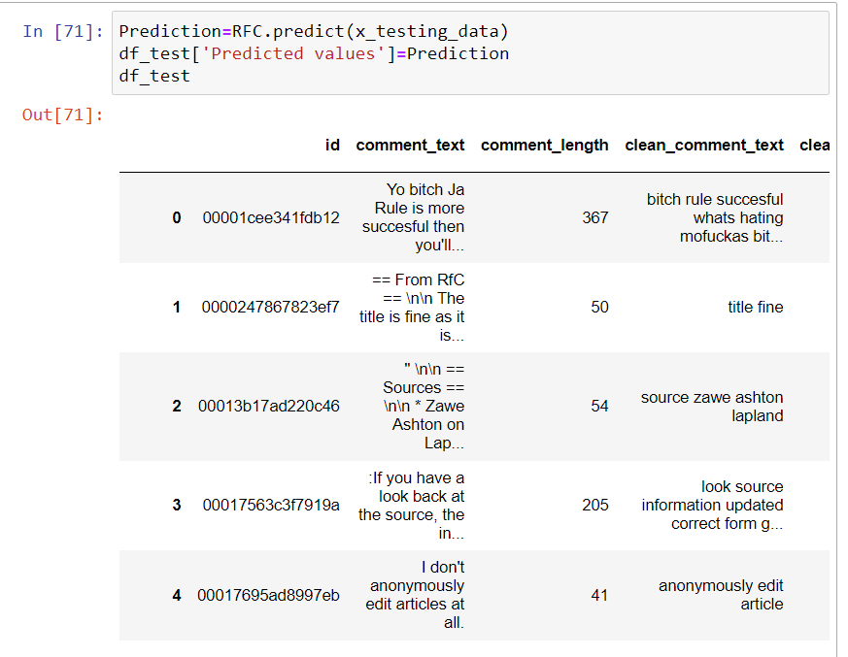
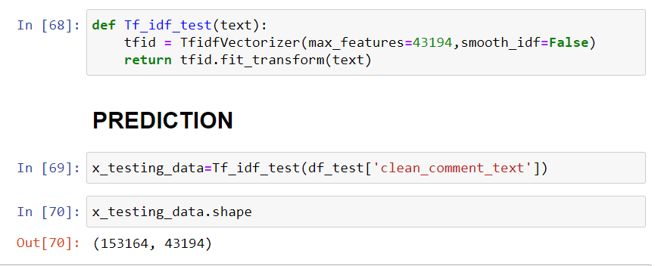
PREDICTED VALUES
The “clean comment text” feature has a notable reduction in the number of characters.

Slide 32
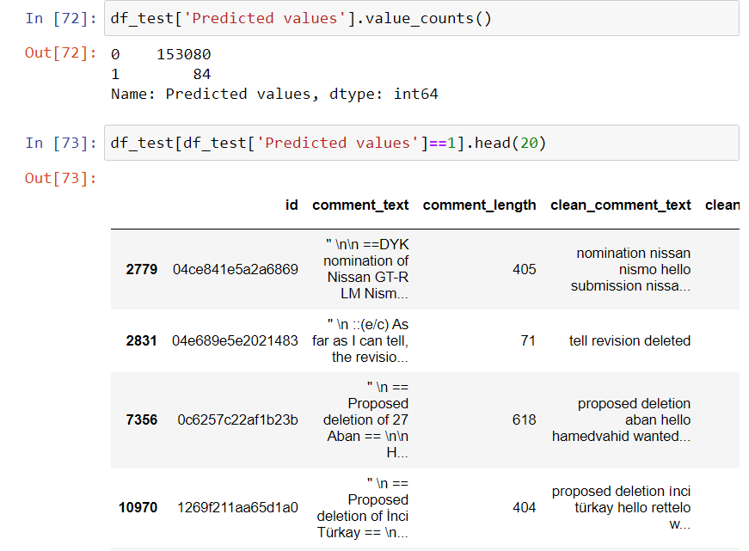
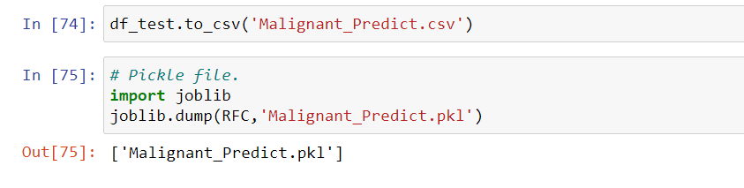
PREDICTED VALUES
The “clean comment text” feature has a notable reduction in the number of characters.

Slide 33
CONCLUSION
Using a Random Forest Model, I have successfully predicted the comments given in the test data to be Negative vs Non-Negative (Positive and Neutral).
Limitations:
Some of the limitations can be:
The model might not be able to understand sarcasm.
Sometimes non-negative comments can be wrongly classified as negative ones, leading to loss of constructive feedback or comments.

Slide 34
CONCLUSION
KEY FINDINGS AND CONCLUSIONS OF THE STUDY
Online hate, described as abusive language, aggression, cyberbullying, hatefulness and many others has been identified as a major threat on online social media platforms. Social media platforms are the most prominent grounds for such toxic behaviour.
From the above analysis the below mentioned results were achieved which depicts the chances and conditions of a comment being a hateful comment or a normal comment.

Slide 35
CONCLUSION
With the increasing popularity of social media, more and more people consume feeds from social media and due differences they spread hate comments to instead of love and harmony. It has strong negative impacts on individual users and broader society.

